Slide 1
Rare Disease Day: lesson slides (ages 8-12)

Slide 2
Lesson Aims
To be introduced to Rare Disease Day and why it exists.
To explore what it is like to live with a rare disease.
To discuss the importance of empathy and inclusion.

Slide 3
What does rare mean to you?
Notes:
Ask children to discuss this with their classmates.
Invite the children to share their answers.

Slide 4
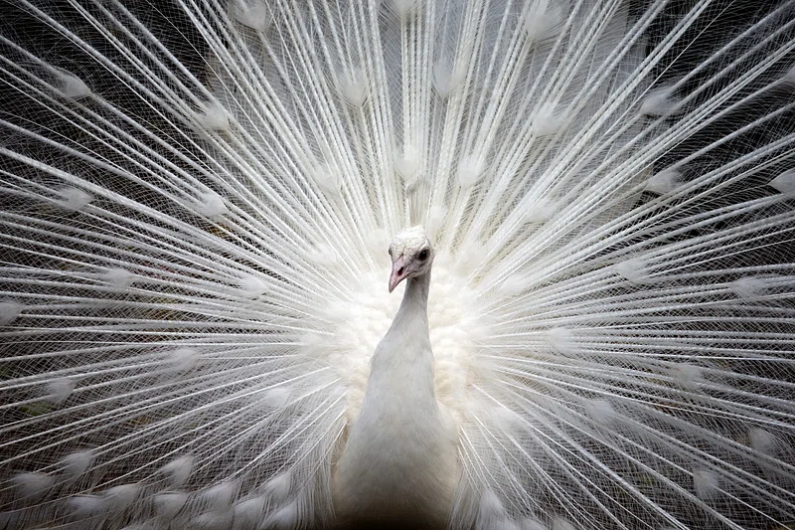
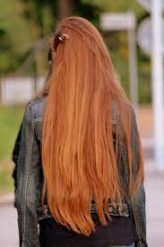
Spot the Rare
Notes:
This slide shows a selection of some ‘rare’ things. Four leaf clovers are believed to be lucky, as the fourth leaf is a result of a genetic mutation in the plant. People with naturally ginger hair only make up 2% of the world’s population making it a rare hair colour. The chances of a white peacock being born is 1 in 30,000, making it a rare species of the bird.
Ask the children to discuss with the person sitting next to them why these images represent ‘rare’.
Ask the children to share their answers.
Explain that like the things in these images, rare diseases are uncommon and hard to find.

Slide 5
Notes:
Ask the children if they can guess which country is the third largest by population (answer is USA).
Explain to the class that although rare means something uncommon, many people are affected by a diverse range of rare diseases around the world. Rare diseases are often genetic, some are life-threatening and some are chronic and can be difficult to live with.
Play introduction to Rare Disease Day video.
Option 1: https://www.youtube.com/watch?v=zEQ828Lkxac
Option 2: https://www.youtube.com/watch?v=3bxaP9FJKnk&t=1s
Option 3: https://www.youtube.com/watch?v=vORB18tPwww

Slide 6
Visualising the Stats
Around 1 in 17 people will be affected by a rare condition at some point in their lives. The purple smiley face in the image below demonstrates someone who has been affected by a rare condition.
Notes:
Choose 17 pupils to stand facing the front of the class, and ask one of the pupils to sit down.
Explain that the pupil who has been asked to sit down represents someone who has been affected by a rare condition. Tell the children that the pupil who is sitting down may have to wait on average 4 years for a diagnosis of their condition, which means it might be difficult for doctors to know how to help them.
Ask the child who is sitting down to explain how this makes them feel, they may say alone, scared, or isolated.
Reference: https://www.eurordis.org/rare-disease-policy/european-policy/

Slide 7
How would YOU feel?
Notes:
Ask the children to imagine how they might feel if they had a rare disease and a doctor didn’t know how to help them or you can invite children to share stories of their own experiences of how they are affected by rare diseases.
Gather children’s answers in the thought bubble template provided in the slide. You may wish to print this off and make it larger.
Link this part of the lesson to the themes of empathy and inclusion, emphasise that although someone may look different or have different experiences to ourselves it’s important that we listen to them and include them because we are all unique in our own ways.

